Slide 1
Ethernet EMAC PHY Basics
By: Gokul and Mir

Slide 2
Agenda
QNX Network Manager (io-pkt)
EMAC and PHY Blocks
Medium-Dependent Interface(MDI)
MDC and MDIO
Accessing PHY using Clause22 and Clause45 via Clause 22 Indirect
Media Independent Interface and its variants
MDIO Clause – 45
MDIO Clause-45 frame format
MDIO Clause-45 addressing
Implementation of Clause-45 API

Slide 3
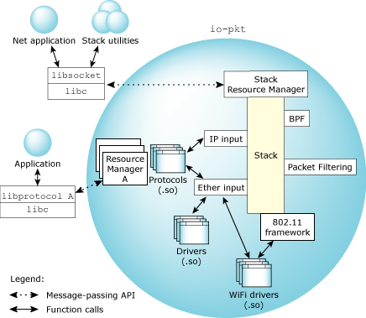
QNX Network Manager (io-pkt)
Consists of io-pkt executable(io-pkt-v4, io-pkt-v4-hc, or io-pkt-v6-hc) and one or more shared library.
Shared library can be protocols(lsm-qnet.so) or drivers(libdevnp-emac-eth.so, libdevnp-speedo.so).
Notes:
The io-pkt stack is very similar to other res mgr. At the bottom layer, are drivers that provide the mechanism for passing data to and receiving data from the hardware. The drivers hook into a multi-threaded layer-2 component (that also provides fast forwarding and bridging capability) that ties them together and provides a unified interface for directing packets into the protocol-processing components of the stack. This includes, for example, handling individual IP and upper-layer protocols such as TCP and UDP.
Stacks has ethernet interface for all ethernet driver and 802.11 mgmt interface for all wireless drivers.
The hc variants of the stack also include a separate hardware crypto API that allows the stack to use a crypto offload engine when it's encrypting or decrypting data for secure links.

Slide 4
Running io-pkt & ethernet mac driver
Load the driver when the io-pkt is started.
io-pkt-v6-hc -d /lib64/libdevnp-emac-eth.so or io-pkt-v6-hc –d devnp-emac-eth
Load/Unload the driver dynamically.
mount –T io-pkt /lib64/libdevnp-emac-eth.so
ifconfig emac0 destroy
Can run multiple instance of io-pkt for network segmentation.

Slide 5
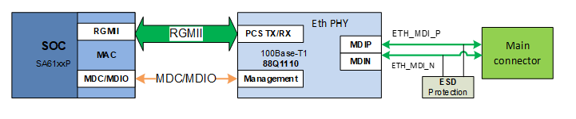
EMAC & PHY
Data transferred between EMAC and PHY
Management Interface for PHY
Notes:
What is EMAC? Ethernet Media Access Controller handles Ethernet packet framing, checksum generation/verification for error detection, packet filtering, DMA to/from system memory, etc.
What is PHY? Physical Layer responsible for transfer of raw binary data over physical medium like copper wire, optical fibers, etc. Responsible for encoding/decoding data into electrical or light signals, modulation/demodulation, signal amplification, noise filtering and managing physical connection between the connected devices.
EMAC resides inside SOC. PHY is outside the SOC. EMAC/PHY communicates via two sets of interfaces. MII and MDIO.

Slide 6
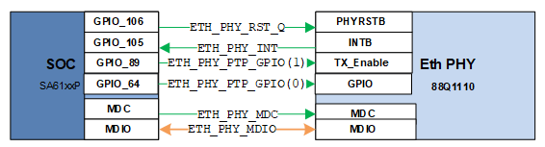
MDI
Notes:
Look into how Controller manages PHY
2-wire serial bus
MDIO is used for configuring and monitoring various parameters of the PHY, such as link status, speed ability and selection, power down for low power consumption, duplex mode (full or half), auto-negotiation, fault signalling, and loopback
MDC is typically the clock signal for this interface. driven by the MAC device to the PHY.
Data is bi-directional in MDIO, but all communications are initiated by MAC

Slide 7
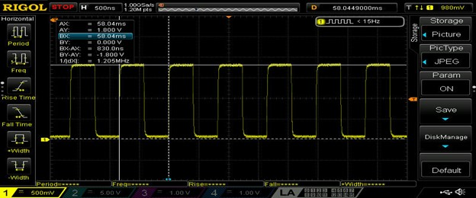
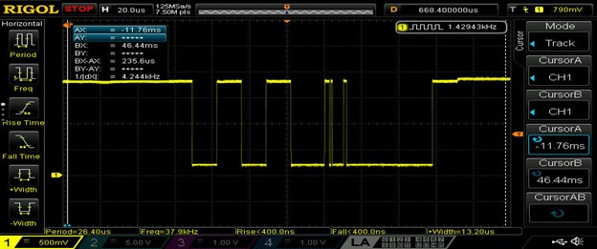
MDC/MDIO
MDC Clock
MDIO Data Transfer
Notes:
MDC can be periodic, with a minimum period of 400 ns, which corresponds to a maximum frequency of 2.5 MHz. Newer chip supports 25 Mhz Clock.
MDC run only when MDIO communication is needed. It halts after communication.

Slide 8
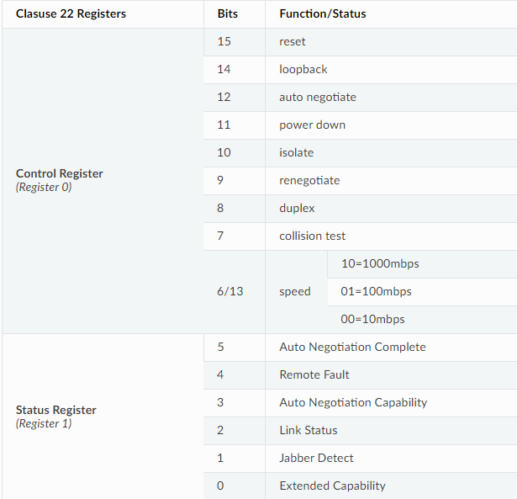
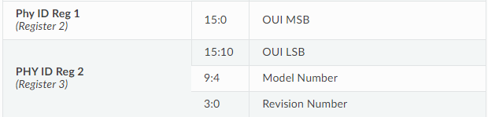
Clause 22 Registers
Write 0x80 on Phy Register 0 for Soft Reset
01 01 00001 00000 10 0000000010000000
Bit 2 of Phy Register 1 will tell the link status
01 10 00001 00001 00 xxxxxxxxxxxxxxxx
Phy ID can be read from Phy Register 2 and Register 3
Notes:
We have mentioned MDIO is serial interface driven by MDC. Lets look at how MDIO frame format and how it is transferred.

Slide 9
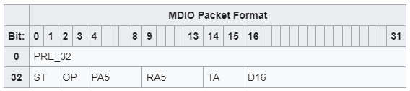
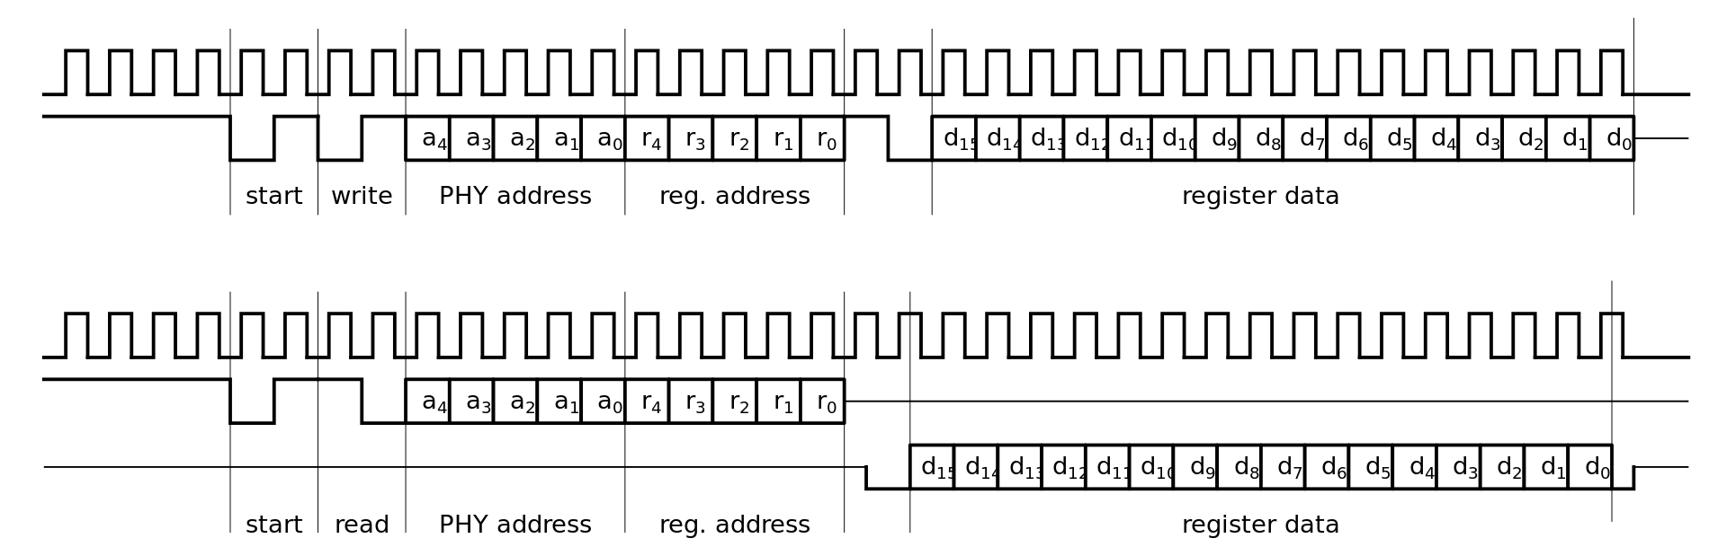
Clause 22 format
32-bit preamble
16-bit control
16-bit data
Only 2 opcodes(10 read & 01 write)
Notes:
During the preamble, the MAC sends 32 bits, all '1', on the MDIO line.
The Start field consists of 2 bits and always contains the combination ‘01’
The Opcode consists of 2 bits. There are two possible opcodes, read '10' or write '01’
5 bits, PHY address – Max PHY Addr 32(0 – 31)
The Register Address field indicates the register to be written to or read from. It is 5 bits long. – Max Register Addr 32(0 – 31)
The turn-around field is 2 bits long. When data is being written to the PHY, the MAC writes '10' to the MDIO line. When data is being read, the MAC releases the MDIO line
16 bits, data

Slide 10
Clause 22 Limitation and Clause 45
Maximum number of register supported by Clause 22 is 32(0 – 31).
Ethernet Phys became more complicated and supported different speeds and connections and needs larger set of registers to access all the information.
IEEE 802.3 Clause 45 with 16-bit register support was added (65536 registers).
Older MAC can do only Clause 22 and newer PHYs need Clause 45.

Slide 11
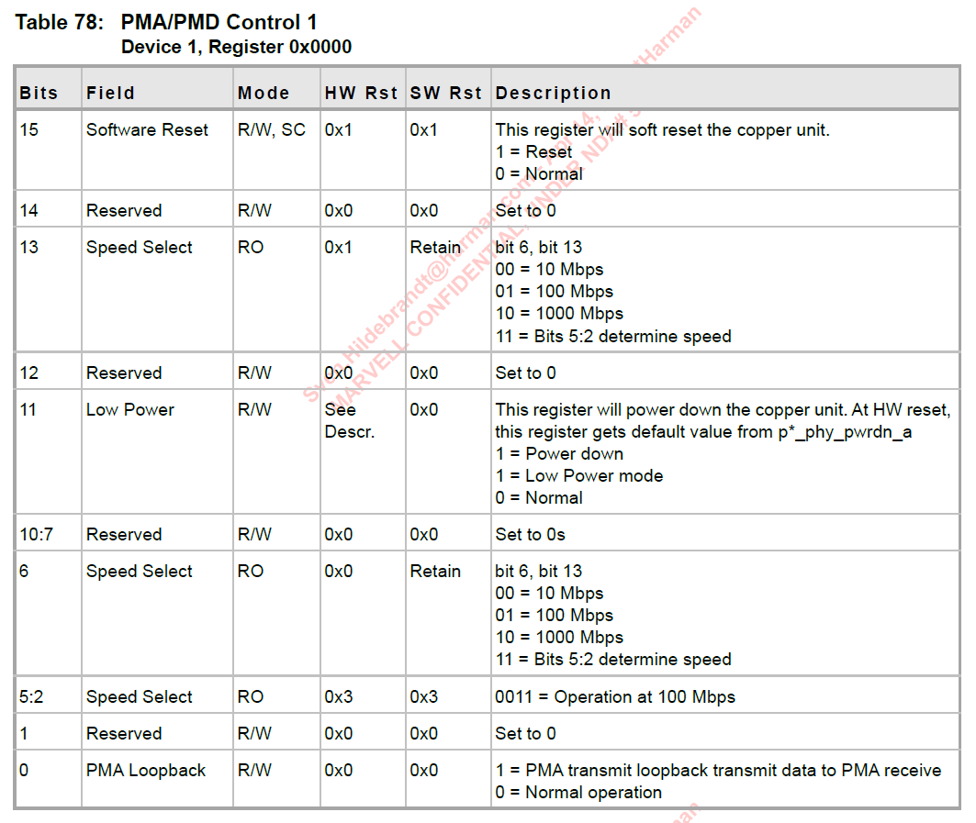
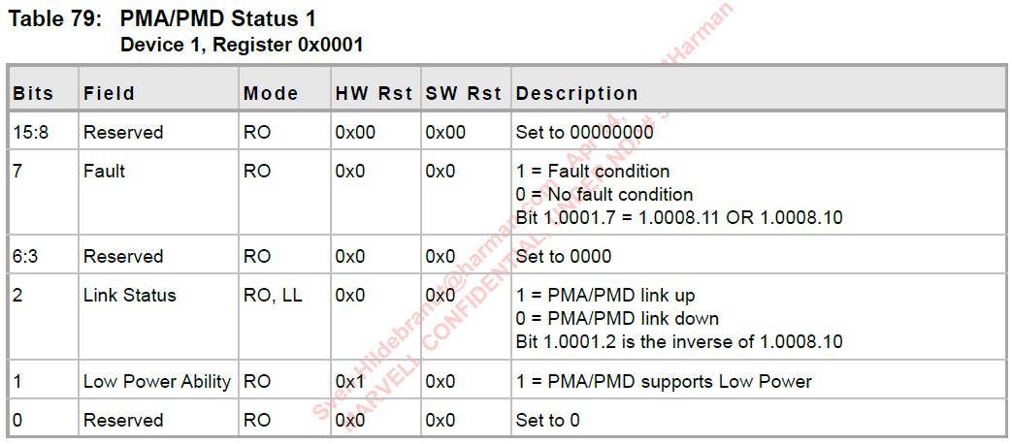
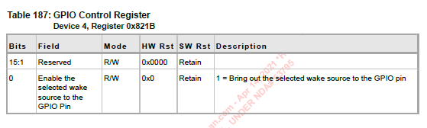
Clause 45 Registers

Slide 12
Clause 45 via Clause 22 Indirect
Write 0x80 to Dev 1 Register 0 to soft reset the PHY.
st op pa reg ta fn dev
01 01 00001 01101 10 0000000000000001
01 01 00001 01110 10 0000000000000000
01 01 00001 01101 10 0100000000000001
01 01 00001 01110 10 1000000000000000
32-bit preamble
16-bit control
16-bit data
4 opcodes
Address 00
Write 01
Read incr 10
Read 11
2 new registers
Register 13 & 14
Specifies which PHY/DEV we are going to access
Specifies which operation we are doing(read or write)

Slide 13
Block diagram showing connectivity in an Ethernet Device
Rx/Tx Clock
PHY
MAC
MII / RGMII…
Tx Signals
Magnetics
RJ-45
CPU
Rx Signals
MDIO
MDIO Clock
MDIO Data
1. MDIO acts as the high-level control.
II. MII provides the high-speed data throughput.

Slide 14
Media Independent Interface
MII (Media Independent Interface)
The MII is standardized by IEEE 802.3u and connects different types of PHYs to MACs. Being media independent means that different types of PHY devices for connecting to different media (i.e. twisted pair, fiber optic, etc.) without redesigning or replacing the MAC hardware.
Thus, any MAC may be used with any PHY.
The Management Data Input/Output (MDIO) serial bus is a subset of the MII that is used to transfer management information between MAC and PHY.
The original MII design has been extended to support reduced signals and increased speeds. Current variants include:
Reduced media-independent interface (RMII)
Gigabit media-independent interface (GMII)
Reduced gigabit media-independent interface (RGMII)
Serial media-independent interface (SMII)
Serial gigabit media-independent interface (serial GMII, SGMII)
High serial gigabit media-independent interface (HSGMII)
Quad serial gigabit media-independent interface (QSGMII)
10-gigabit media-independent interface (XGMII)

Slide 15
Media Independent Interface
MII/Standard MII: -
Standard MII is driven with set of 16 signals.
The original MII transfers network data using 4-bit nibbles in each direction (4 transmit data bits, 4 receive data bits). The data is clocked at 25 MHz to achieve 100 Mbit/s throughput.
MII (100BASE-TX) - - -> TXCLK = 25 MHz
MII (10BASE-T) - - - > TXCLK = 2.5 MHz
For MII, the MAC controller asserts TXEN to indicate valid data.
The data is latched by the transceiver’s MII block on the rising edge of TXCLK.

Slide 16
Media Independent Interface
MII/Standard MII: -
MII signal details: -
Signal | Description | Direction
TXD[3:0] | Data nibble transmitted by EMAC | MAC to PHY
TX_CLK | Transmitter Clock | PHY to MAC
TX_EN | Indicates that valid transmission data is present on TXD[3:0]. | MAC to PHY
TX_ER | Transmit error: TX_ER may be raised for one or more clock periods during frame transmission to request the PHY to deliberately corrupt the frame. | MAC to PHY
CRS | Carrier Sense: This signal indicates detection of a carrier. | PHY to MAC
COL | Collision Detect: | PHY to MAC

Slide 17
Media Independent Interface
MII/Standard MII: -
Signal | Description | Direction
RXD[3:0] | Data nibble to be received by EMAC | PHY to MAC
RXCLK | Receive Clock Output: MII (100BASE-TX): 25 MHz, MII (10BASE-T): 2.5 MHz | PHY to MAC
RXDV | Receive Data Valid: Indicates that recovered and decoded data is available on RXD pins. RX_DV is not required to go high immediately when the frame starts but must do so in time to ensure the "start of frame delimiter" byte is included in the received data. Some of the preamble nibbles may be lost. | PHY to MAC
RX_ER | Receive Error | PHY to MAC

Slide 18
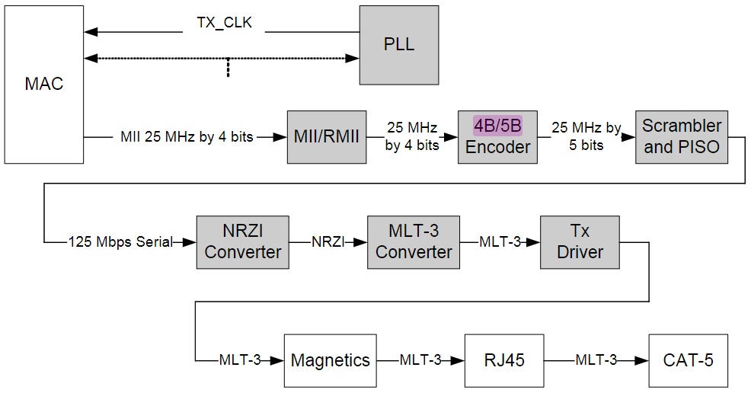
Media Independent Interface
MII/Standard MII data on wire: -
MII 100 Mbps Transmit Data path

Slide 19
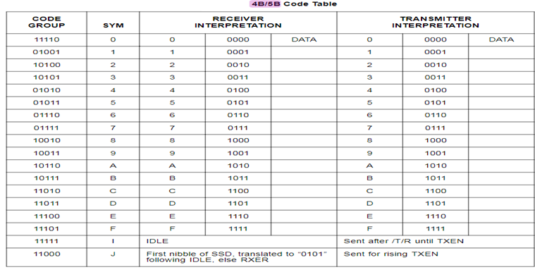
Media Independent Interface
MII/Standard MII data on wire: -
4B/5B Encoding: - 4B5B maps groups of 4 bits of data onto groups of 5 bits for transmission. These 5-bit words are pre-determined in a dictionary, and they are chosen to ensure that there will be sufficient transitions in the line state to produce a self-clocking signal.
An alternative to using 4B5B coding is to use a scrambler. Some systems use scramblers in conjunction with 4B5B coding to assure DC balance and improve electromagnetic compatibility.

Slide 20
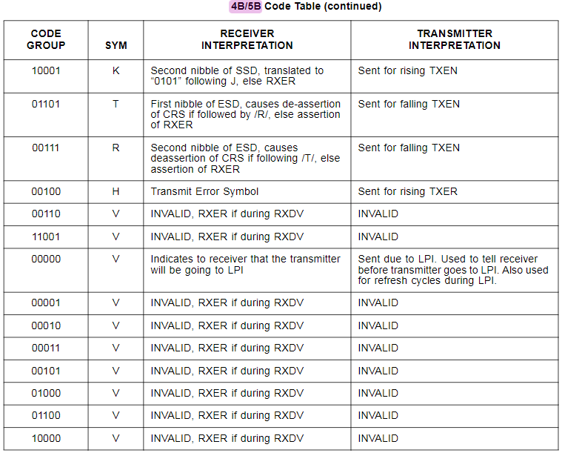
Media Independent Interface
MII/Standard MII data on wire: -
4B/5B Encoding: -

Slide 21
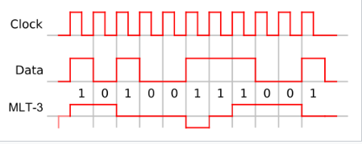
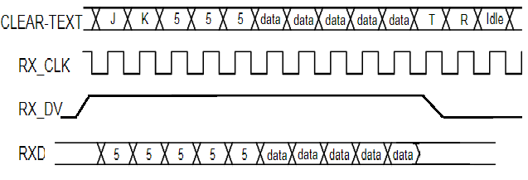
Media Independent Interface
MII/Standard MII data on wire: -
MLT-3 Encoding: - MLT-3 encoding (Multi-Level Transmit) is a line code that uses three voltage levels.
Receive Data Timing Diagram: -
RXDV becomes active after the /J/K/delimiter has been recognized and RXD is aligned to nibble boundaries. It remains active until eitherthe /T/R/ delimiter is recognized or link test indicates failure or SIGDET becomes false.
The Start Stream Delimeter, /J/K/, is translated to “0101 0101”as the first 2 nibbles of the MAC preamble.

Slide 22
I. Reduced Media Independent Interface (RMII)
RMII Signal Details: -
RMII interface requires 9 signals, versus MII’s 16 signals (excluding 2 MDIO signals which is common for both).
The REF_CLK operates at 50 MHz in both 100 Mbit/s mode and 10 Mbit/s mode.
Signal | Description | Direction
TXD[1:0] | Transmit Data bits | MAC to PHY
RXD[1:0] | Receive Data bits | PHY to MAC
REF_CLK | Continuous 50 MHz reference clock | Reference clock may be an input on both devices from an external clock source, or may be driven from the MAC to the PHY, or may be driven from the PHY to the MAC
TX_EN | When high, clock data on TXD0 and TXD1 to the transmitter | MAC to PHY
CRS_DV | Carrier Sense (CRS) and RX_Data Valid (RX_DV) multiplexed on alternate clock cycles. In 10 Mbit/s mode, it alternates every 10 clock cycles. | PHY to MAC
RX_ER | Receive error | PHY to MAC

Slide 23
II. Gigabit media-independent interface (GMII)
GMII interface operates at speeds up to 1000 Mbit/s, implemented using a data interface clocked at 125 MHz with separate eight-bit data paths for receive and transmit, and is backwards compatible with the MII specification and can operate at speeds of 10 or 100 Mbit/s.
GMII Transmitter Signals:
There are two transmitter clocks. For gigabit operation, the GTXCLK is supplied to the PHY. For 10 or 100 Mbit/s operation, the TXCLK is supplied by the PHY, and it operates at either 25 MHz for 100 Mbit/s or 2.5 MHz for 10 Mbit/s connections.
Signal | Description
GTXCLK | Clock signal for gigabit TX signals (125 MHz)
TXCLK | Clock signal for 10/100 Mbit/s signals
TXD[7..0] | Data to be transmitted
TXEN | Transmitter enable
TXER | Transmitter error (used to intentionally corrupt a packet, if necessary)

Slide 24
II. Gigabit media-independent interface (GMII)
GMII Receiver Signals:
GMII receiver uses a single clock signal recovered from the incoming data.
Signal | Description
RXCLK | Received clock signal (recovered from incoming received data)
RXD[7..0] | Received data
RXDV | Signifies data received is valid
RXER | Signifies data received has errors
COL | Collision detect (half-duplex connections only)
CS | Carrier sense (half-duplex connections only)

Slide 25
II. Reduced Gigabit media-independent interface (RGMII)
The reduced gigabit media-independent interface (RGMII) uses half the number of data pins as are used in the GMII interface. This reduction is achieved by running half as many data lines at double speed, time multiplexing signals and by eliminating non-essential carrier-sense and collision-indication signals.
RGMII consists only of 14 pins, as opposed to GMII's 24 to 27.
Data is clocked on rising and falling edges for 1000 Mbit/s, and on rising edges only for 10/100 Mbit/s.
The RX_CTL signal carries RXDV (data valid) on the rising edge, and (RXDV xor RXER) on the falling edge.
The TX_CTL signal likewise carries TXEN on rising edge and (TXEN xor TXER) on the falling edge. This is the case for both 1000 Mbit/s and 10/100 Mbit/s.

Slide 26
II. Reduced Gigabit media-independent interface (RGMII)
RGMII Signals: -
Signal | Description | Direction
TXC | Clock signal | MAC to PHY
TXD[3..0] | Data to be transmitted | MAC to PHY
TX_CTL | Multiplexing of transmitter enable and transmitter error | MAC to PHY
RXC | Received clock signal (recovered from incoming received data) | PHY to MAC
RXD[3..0] | Received data | PHY to MAC
RX_CTL | Multiplexing of data received is valid and receiver error | PHY to MAC

Slide 27
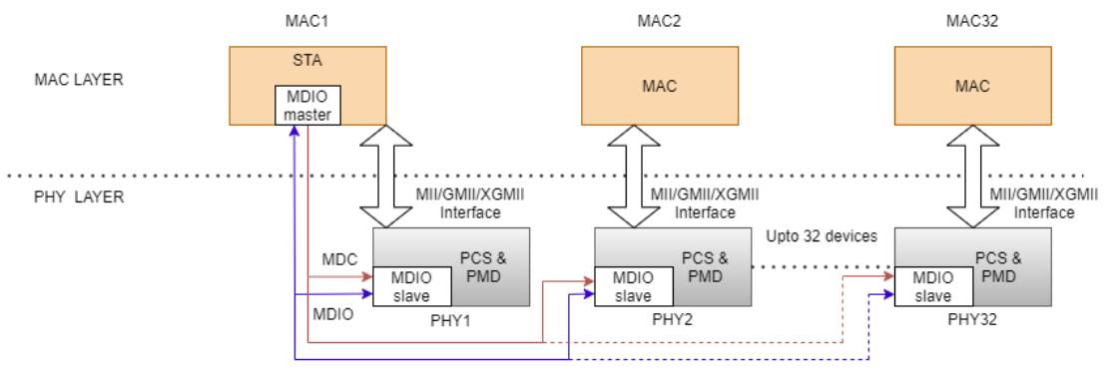
MDIO
MDIO:-
Management Data Input/Output (MDIO)
Management Data Input/Output (MDIO) is a serial bus protocol defined for the IEEE 802.3 standard Ethernet series of Media Independent Interface (MII). MII connects media access control (MAC) devices to Ethernet physical layer (PHY) circuits.
The MDIO bus has two signals:
I. MDIO: Bidirectional Data Pins
II. MDC: Management Data Clock (Up to 2.5MHz)

Slide 28
MDIO
MDIO Clause - 45:-
Since Clause-22 can read maximum 32 registers, so there was a need for accessing many more PHY registers for gigabit ethernet devices.
The advantages of clause 45 over clause 22 are as follows:
Accessibility of 65,536 registers in 32 different devices across 32 different ports.
4 Opcodes: Address, Read, Write & Read Increment
Terminal fault signaling. Multiple repeaters.
Low voltage specification

Slide 29
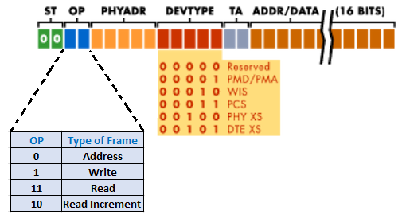
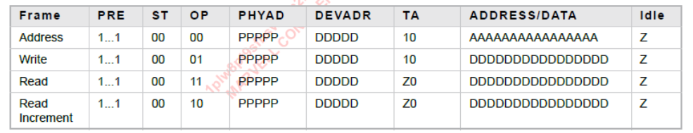
MDIO
MDIO Clause – 45 frame format:-

Slide 30
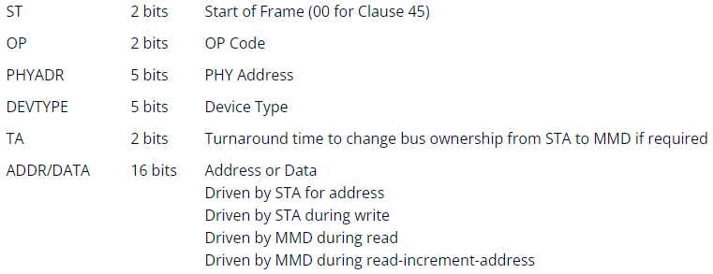
MDIO
MDIO Clause – 45 frame format:-
The primary change in Clause 45 is how the registers are accessed. In Clauses 22, a single frame specified both the address and the data to read or write. But in case of Clause 45, first an address frame is sent to specify the MMD and register. A second frame is then sent to perform the read or write.
The benefits of adding this two-cycle access makes Clause 45 backwards compatible with Clause 22, allowing devices to interoperate with each other. Secondly, by creating an address frame, the register address space is increased from 5 bits to 16 bits, which allows an STA to access 65,536 different registers.

Slide 31
MDIO
MDIO Clause – 45 addressing:-
Reg - 0
Port - 0
Dev - 0
Reg - n
PHY - 1
CPU
Reg - 0
Dev - 31
Reg - n
EMAC
MDIO Bus
Reg - 0
Dev - 0
Reg - n
PHY - 32
Dev - 31
Reg - 0
Port - 31
Reg - n

Slide 32
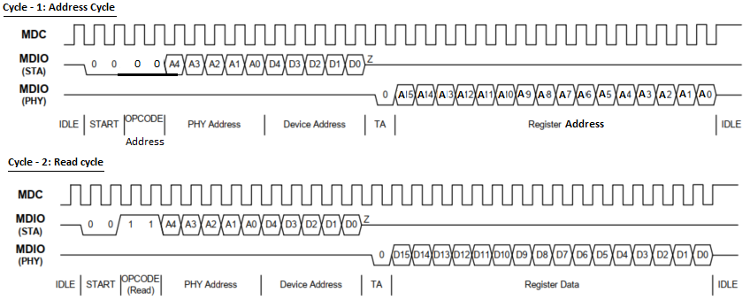
MDIO
Typical Clause-45 read operation: -

Slide 33
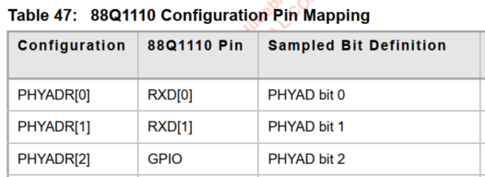
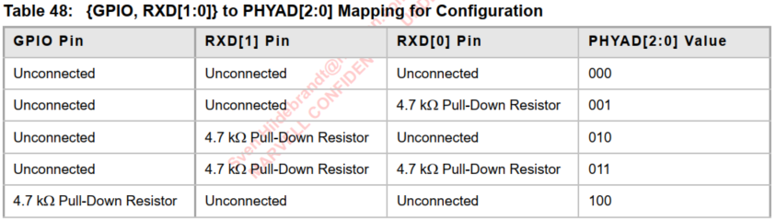
MDIO
Determination of PHY_ADDR by Ethernet PHY:-
Example: Marvel 88Q111x PHY
PHY address bits [2:0] of the PHY address are configured during the hardware reset sequence based on Marvel PHY external pins. PHY address bits[4:3] are set to 00 internally in the device. Snapshot from Marvel PHY 88Q111x: -

Slide 34
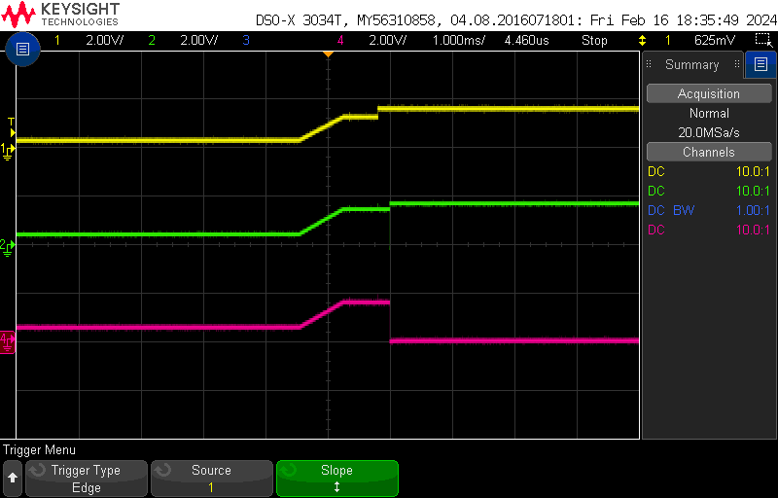
MDIO
Sensing 3 bits of PHY_ADDR by Ethernet PHY at Reset Sequence:-
Waveform showing PHY address for Marvel PHY 88Q111x to be 000b: -
Legend: -
Yellow: PTP_GPIO
Green: RXD1
Violet: RXD0
Initially, all above pin levels are HIGH, so it is interpreted as address – 0, as per Marvel88Q datasheet.

Slide 35
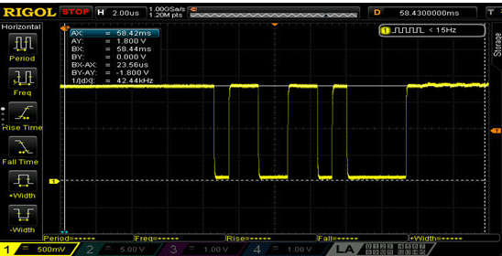
MDIO
Comparison between Clause-22 and Clause-45 waveforms: -
Clause-22 MDIO data: -
Legend: - MDIO data
Bit pattern from above waveform: [0 1] [ 1 0 ] [0 1 1 0 1] [ 0 0 0 0 0]
Leading bits : 0 1 indicates clause – 22

Slide 36
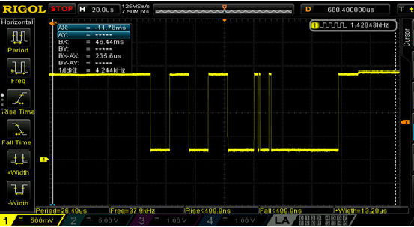
MDIO
Comparison between Clause-22 and Clause-45 waveforms: -
Clause-45 MDIO data: -
Legend: - MDIO data
Two initial zero bits at the start of packet, indicates that EMAC is configured to send data on Clause -45.

Slide 37
MDIO
Implementation of Clause-45 direct mode API: -
QNX BSP Code base for Space-4 has support of MDIO Clause-22 only. As the Marvel PHY connected on board is having Clause-45 registers. To access Clause-45 registers using Clause-22 indirect mode involves 4 cycles for every register read and write, as compared to only 2 cycles only needed with Clause-45 direct mode.
Hence, to make optimized communication Clause-45 based APIs are implemented, as QC-6155 SOC supports Clause-45 as well.
Gerrit: -
https://gerrit1.harman.com/c/GTC_Foundation_Software/Integration/QNX/Platform/HQX/BSP/+/245434

Slide 38
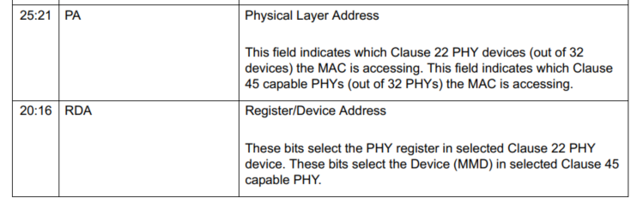
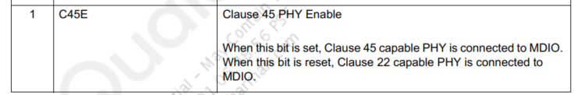
MDIO
Implementation of Clause-45 direct mode API: -
Important MDIO registers for MDIO communication in QC-6155 SOC: -
Register: EMAC_MAC_MDIO_ADDRESS (Address - 0x00020200 ) { Important Bits}

Slide 39
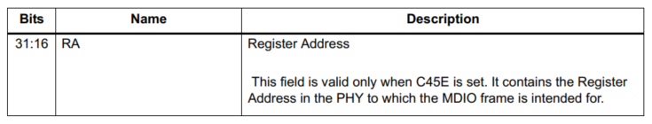
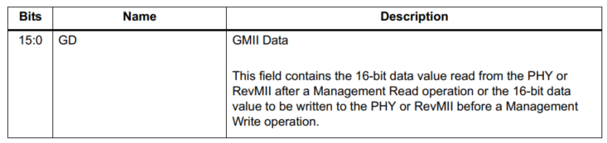
MDIO
Implementation of Clause-45 direct mode API: -
Important MDIO registers for MDIO communication in QC-6155 SOC: -
Register: EMAC_MAC_MDIO_DATA (Address - 0x00020204 ) { Important Bits}

Slide 40
MDIO
Implementation of Clause-45 direct mode API: -
static INT emac_read_phy_regs_c45(INT phy_id, INT dev_addr, INT phy_reg, INT *phy_reg_data)
{
//....
/* wait for any previous MII read/write operation to complete
* by polling Bit - 0 i.e. GB bit of EMAC_MAC_MDIO_ADDRESS register
*/
//....
/*Write PHY Register address*/
MAC_GMIIDR_RgRd(varMAC_GMIIDR);
varMAC_GMIIDR = varMAC_GMIIDR & (0x0000ffff); /*Clear Register address field Bit[31:16]*/
varMAC_GMIIDR = varMAC_GMIIDR | ((phy_reg) << 16);
MAC_GMIIDR_RgWr(varMAC_GMIIDR);
/* wait for any previous MII write operation to complete
* by polling Bit - 0 i.e. GB bit of EMAC_MAC_MDIO_ADDRESS register
*/
/* initiate the MII read operation by updating desired */
/* phy address/id (0 - 31) */
/* device address offset */
/* CSR Clock Range (20 - 35MHz) */
/* Select read operation */
/* Enable Clause 45*/
/* set busy bit */
MAC_GMIIAR_RgRd(varMAC_GMIIAR);
varMAC_GMIIAR = varMAC_GMIIAR & (ULONG) (0x12); /*Specific to Clause 45*/
varMAC_GMIIAR =
varMAC_GMIIAR | ((phy_id) << 21) | ((dev_addr) << 16) | ((0x1) << 8)
| ((0x3) << 2) | ((0x1) << 1) | ((0x1) << 0);
MAC_GMIIAR_RgWr(varMAC_GMIIAR);
/* wait for MII write operation to complete
* by polling Bit - 0 i.e. GB bit of EMAC_MAC_MDIO_ADDRESS register
*/
//....
/* read the data */
MAC_GMIIDR_RgRd(varMAC_GMIIDR);
*phy_reg_data =
GET_VALUE(varMAC_GMIIDR, MAC_GMIIDR_GD_LPOS, MAC_GMIIDR_GD_HPOS);
//....
}

Slide 41
THANK YOU !

